Slide 1
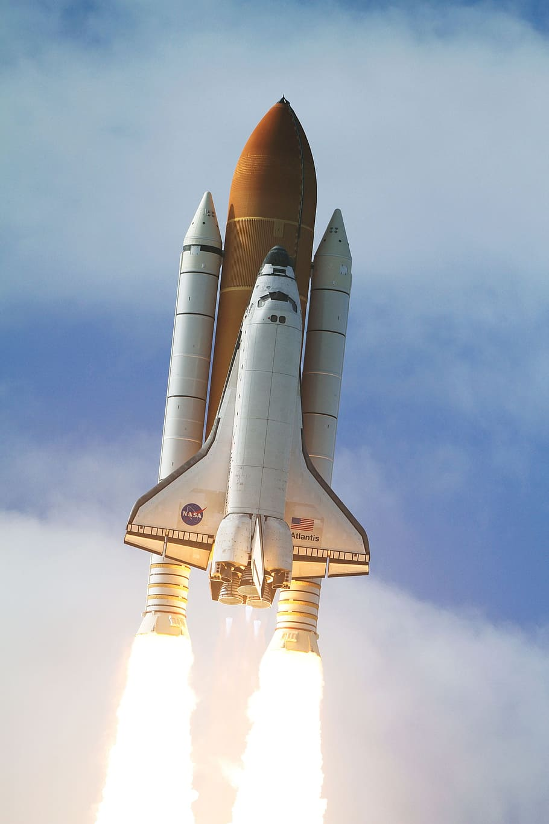
IBM DATA SCIENCE space x capstone project
Namandeep Singh Wadhwa
JULY 10,2023

Slide 2

Outline
Executive Summary
Introduction
Methodology
Results
Conclusion
Appendix

Slide 3

Executive Summary
Methodology
Data Collection with API, Web scrapping and SQL
Data Wrangling and Analysis
Data Visualization
Predictive Models
Summary of All results
Data Analysis
Data Visualization
Predictive Models

Slide 4
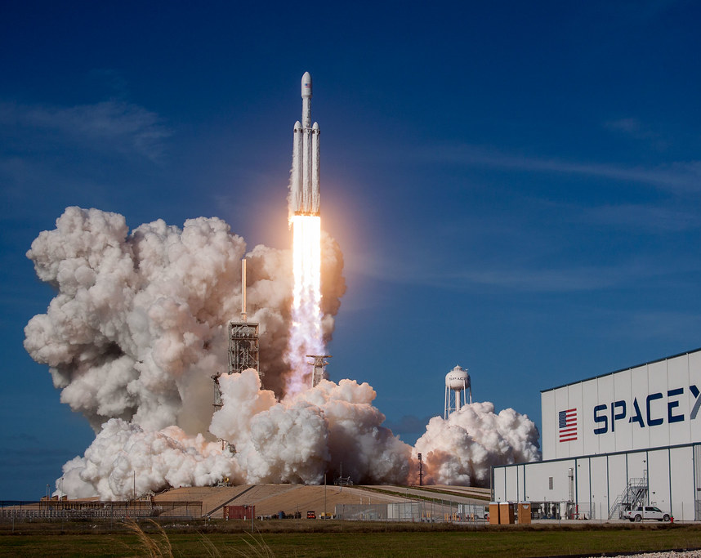
Introduction
Background
In the present era, with the widespread pursuit of faster and more affordable space exploration, SpaceX has emerged as a leading contender. Demonstrating remarkable accomplishments, SpaceX has successfully launched projects like Starlink, a satellite-based internet system, and has sent astronauts into space. The key to SpaceX's extensive engagement lies in its ability to manufacture cost-effective rockets. On their website, SpaceX promotes Falcon 9 rocket launches at a price of $62 million, while other providers charge upwards of $165 million per launch, primarily due to SpaceX's innovative first stage reusability.
Purpose of Project
The main idea behind this project is to find how the different factors such as Payload Mass, orbit effects the success rate and to find the best predictive model

Slide 5

Section 1- Methodology

Slide 6
Methodology
Executive Summary
Data collection methodology:
Data was collected using SpaceX API and web scrapping
Then collected data is read and converted into data frame
Perform data wrangling
Falcon 9 data is separated
Missing payload mass values were replaced by mean
Perform exploratory data analysis (EDA) using visualization and SQL
Perform interactive visual analytics using Folium and Plotly Dash
Perform predictive analysis using classification models
The data is first split into train and test data set
Then data is normalized
Then different prediction model were used with grid search to obtain best result

Slide 7
Data Collection API(GIT https://github.com/NamandeepWadhwa/dataScienceCapstone.git)
Request and parse the SpaceX data using get request
Json data read into data frame
Decoded the response content as json
Falcon 9 data separated
Missing values are handled

Slide 8
Data Collection – Scraping (GIT- https://github.com/NamandeepWadhwa/dataScienceCapstone.git)
Request the Falcon9 launch Wiki page
Extract all column from HTML table header
Create Beautiful Soup
Create a data frame by parsing the launch HTML tables

Slide 9
Data Wrangling (GIT- https://github.com/NamandeepWadhwa/dataScienceCapstone.git)
Get the null values
Selection of correct method for handling nll values
Replacing null values with mean

Slide 10
EDA with Data Visualization (GIT- https://github.com/NamandeepWadhwa/dataScienceCapstone.git)
Success Rate by launch pad
Success rate by Payload Mass
Success rate of orbit
Relationship between payload and orbit

Slide 11
EDA with SQL(GIT- https://github.com/NamandeepWadhwa/dataScienceCapstone.git)
Different Launch site
Total payload carried by specific boosters
First success date
Success rate in a specific payload mass
Ranking count of landing outcome

Slide 12


Build an Interactive Map with Folium (https://github.com/NamandeepWadhwa/dataScienceCapstone.git)
The main was to find the what is common in the launch site locations
Result
All the launch site are closer to Equator
All the launch sites are near to Coastline when compared to Highways, Railways

Slide 13

Summarize what plots/graphs and interactions you have added to a dashboard
Explain why you added those plots and interactions
Add the GitHub URL of your completed Plotly Dash lab, as an external reference and peer-review purpose

Slide 14
Build a Dashboard with Plotly Dash
Success rate of by Launch Site- Pie Chart
Payload Mass vs Launch Site- Scatter Plot
GIT-https://github.com/NamandeepWadhwa/dataScienceCapstone.git

Slide 15
Predictive Analysis (Classification, Git-https://github.com/NamandeepWadhwa/dataScienceCapstone.git)
Among all the predictive model, Decision tree classifier outperformed all the other model and was able to achieve the accuracy of 90 percent
Data Collection
Data Wrangling
Data Normalization
Grid Search with model prediction to get the best result

Slide 16
Results
Exploratory data analysis results
Orbits GEO,HEO and SSO have a perfect success rate
Launch sites have improved success rate over time
Interactive analytics demo in screenshots
All of the sites are closer to equator
All the launch site are close to coast line so that they don’t damage the City in case of failure
Predictive analysis results
Decision Tree Classifier outperform all the predative models by achieving 90 percent accuracy

Slide 17


Insights drawn from EDA

Slide 18
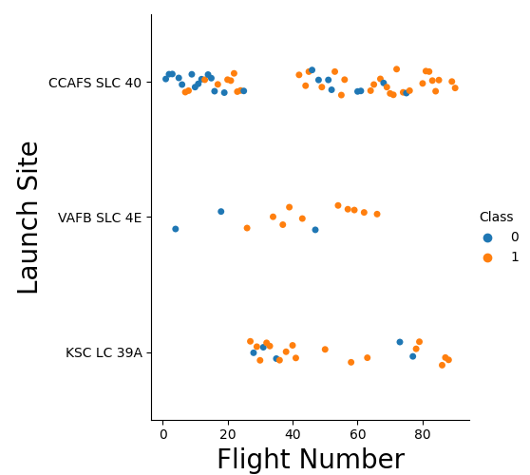
Flight Number vs. Launch Site
Initially for all the sites failure rate was more than the success rate (blue-0 means failure, orange-1 success)
Most of the launches are from CCAFS SLC 40 launch site
Over time success rate improved

Slide 19
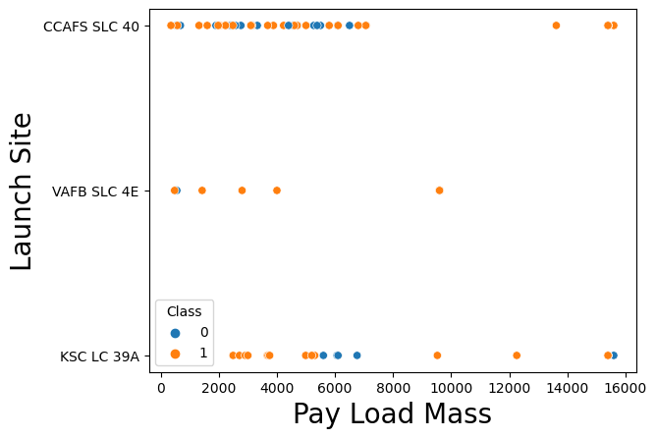
Payload vs. Launch Site
Higher the Pay load Mass more is the success
VAFB CLC 4E launch site did not sent a space ship with a payload mass higher than 10,000

Slide 20
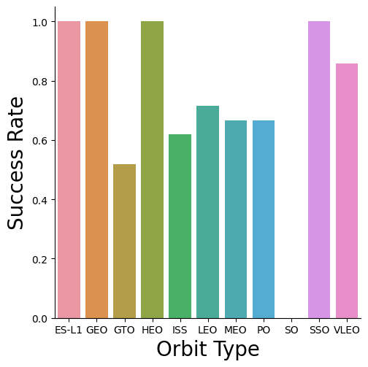
Success Rate VS Orbit Type
Orbits ES-L1, GEO,HEO, and SSO have the highest success rate (100 %).
Orbits GTO has the lowest success rate

Slide 21
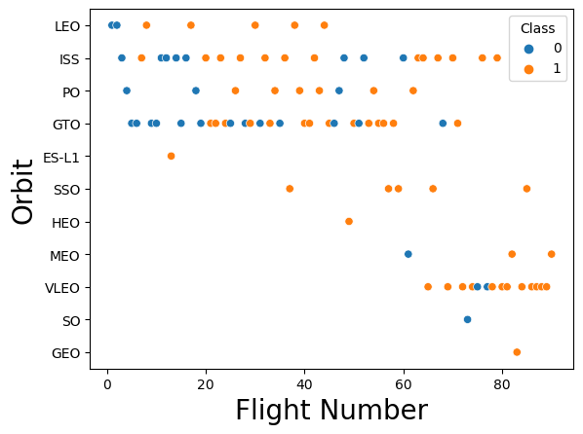
Flight Number VS Orbit
You should see that in the LEO orbit the Success appears related to the number of flights; on the other hand, there seems to be no relationship between flight number when in GTO orbit.

Slide 22
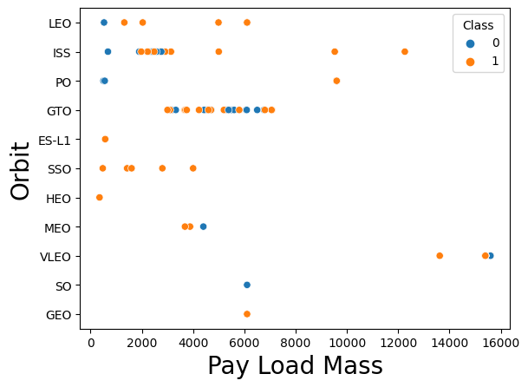
Payload vs. Orbit Type
With heavy payloads the successful landing or positive landing rate are more for Polar,LEO and ISS.
However for GTO we cannot distinguish this well as both positive landing rate and negative landing(unsuccessful mission) are both there here.

Slide 23
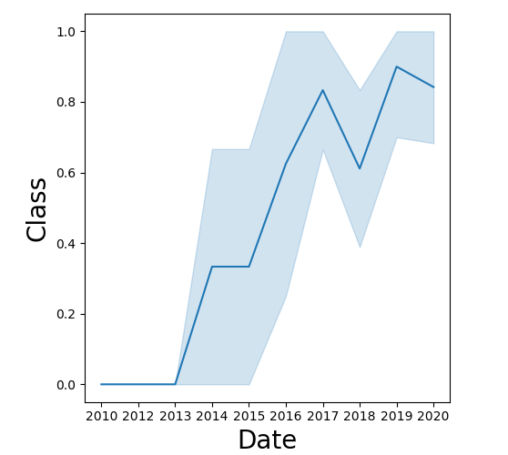
Launch Success Yearly Trend
The success rate is constantly increasing every year expect or they year 2018

Slide 24
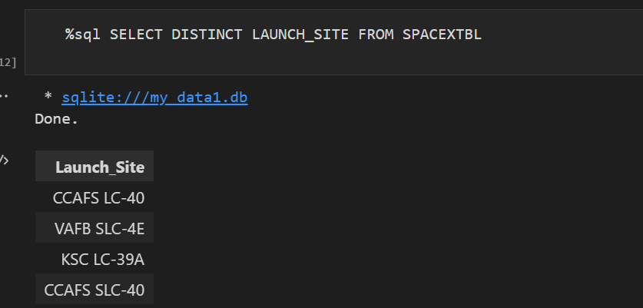
All Launch Site Names
The above query gives us all the launch site name from the table SPACEXTBL

Slide 25
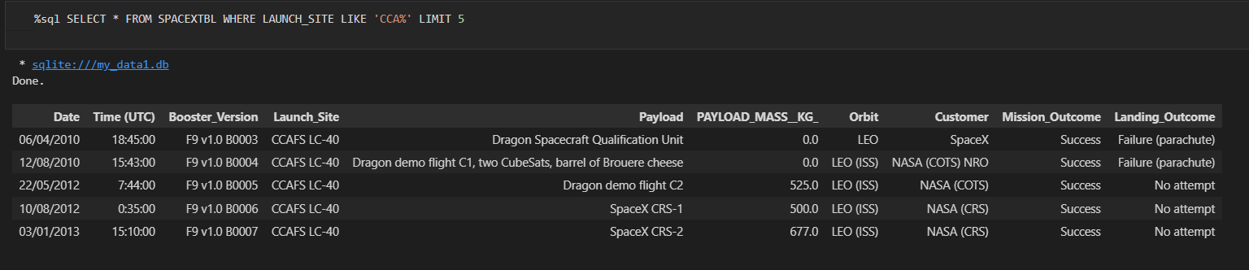
Launch Site Names Begin with 'CCA'
The above query returns the 5 records whose launch site starts with CCA

Slide 26
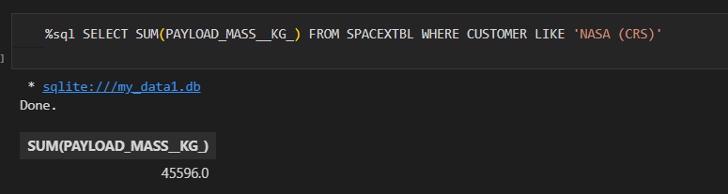
Total Payload Mass
The mentioned query return the total pay load mass carried by NASA (CRS)

Slide 27
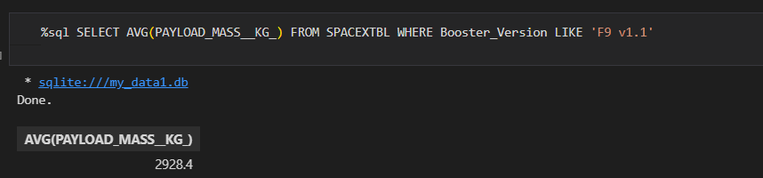
Average Payload Mass by F9 v1.1
As Evident by the query this query returns the Average Payload Mass carried by booster F9 v1.1. It uses the AVG function to get the Average

Slide 28
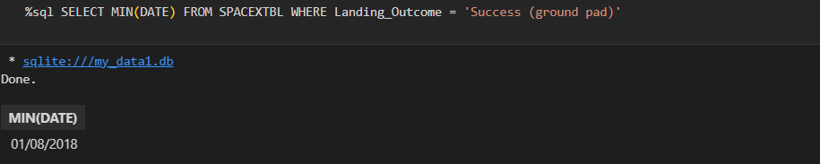
First Successful Ground Landing Date
The query returns the first successful ground landing date (1st August 2018) by using min sql function on the DATE column.

Slide 29
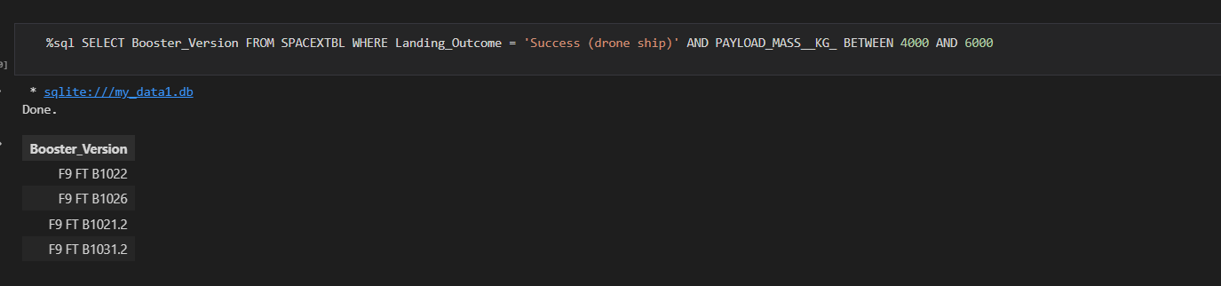
Successful Drone Ship Landing with Payload between 4000 and 6000
The above query returns the boosters who had Successful Drons ship landing with payload mass between 4000 and 6000

Slide 30
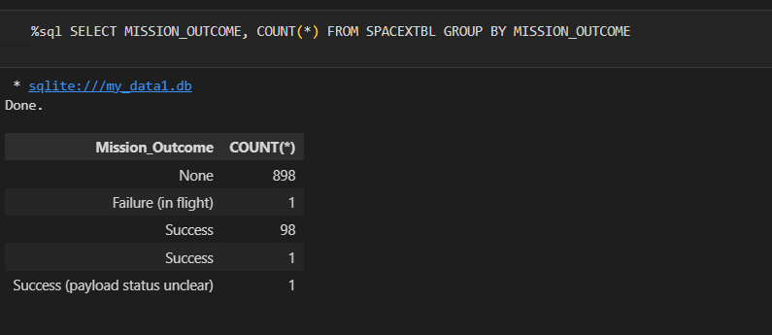
Total Number of Successful and Failure Mission Outcomes

Slide 31
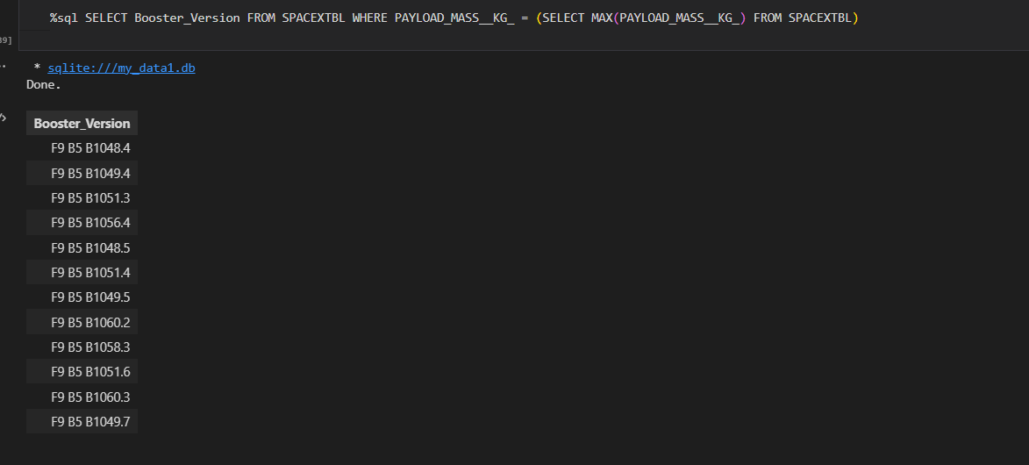
Boosters Carried Maximum Payload
The query uses subquery method to first find the max pay load, then it returns the name of all the boosters that carried Maximum Payload Mass

Slide 32
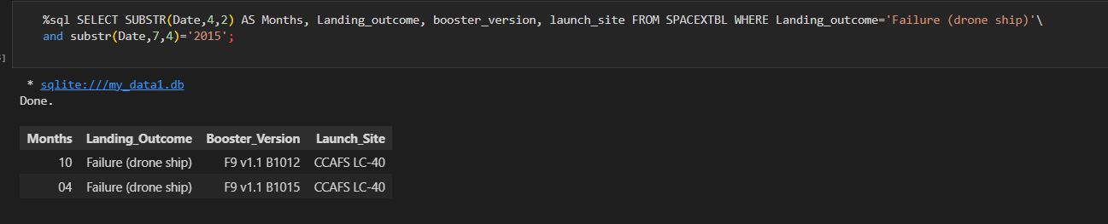
2015 Launch Records

Slide 33
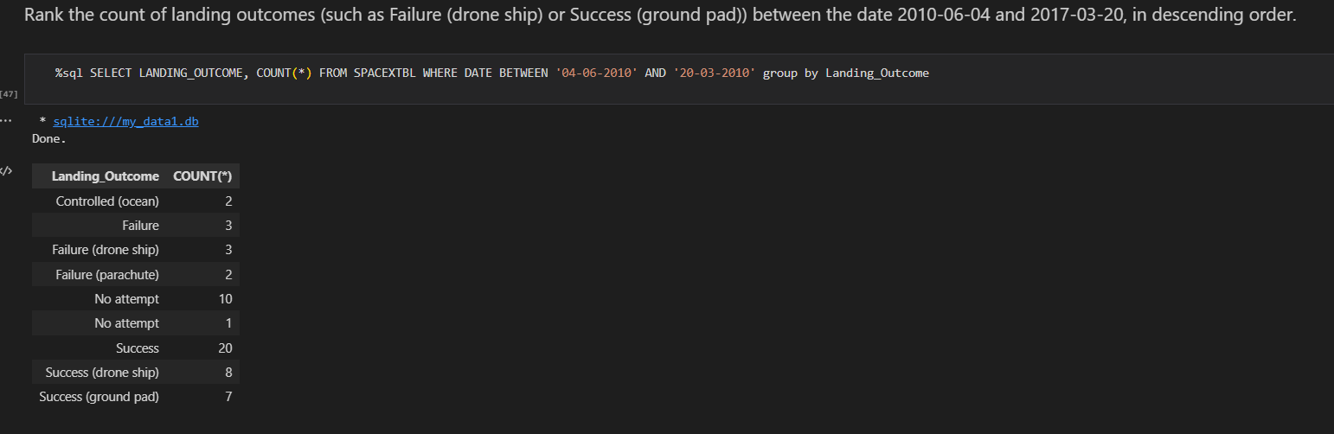
Rank Landing Outcomes Between 2010-06-04 and 2017-03-20

Slide 34

Launch Sites proximity analysis

Slide 35
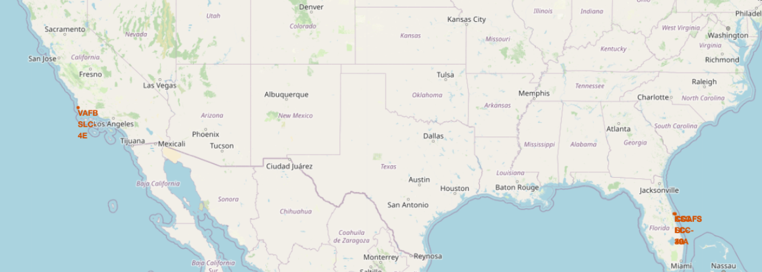
All the launch sites are in North America and are near to quator

Slide 36
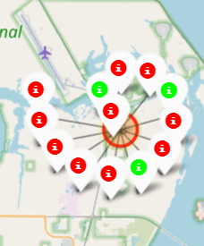
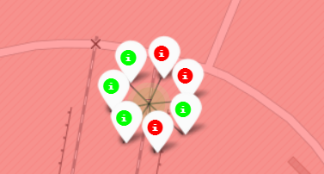
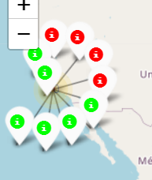
The Green Color marker shows the success and red color marker show the failure

Slide 37
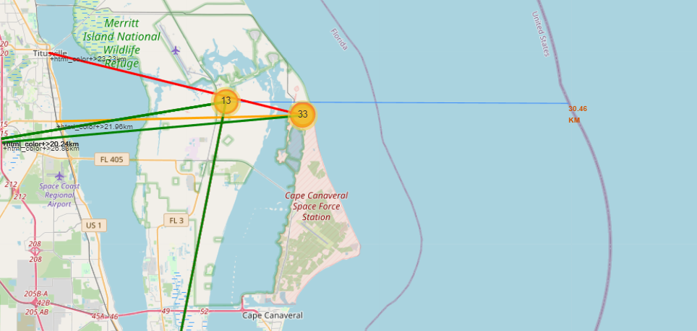
Proximity of Launch site
Launch Sites are near the coast-line as compared Highway, Railway

Slide 38

Dash Board with Plotly Dash

Slide 39
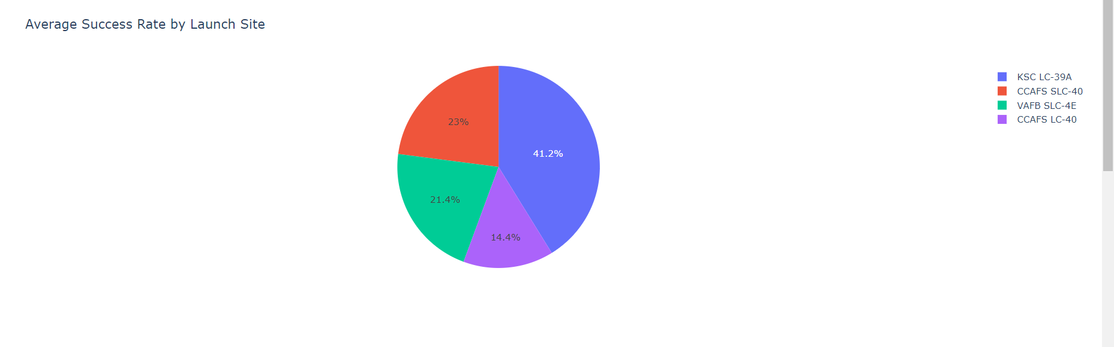
KSC LC-39A has the highest Success Rate

Slide 40
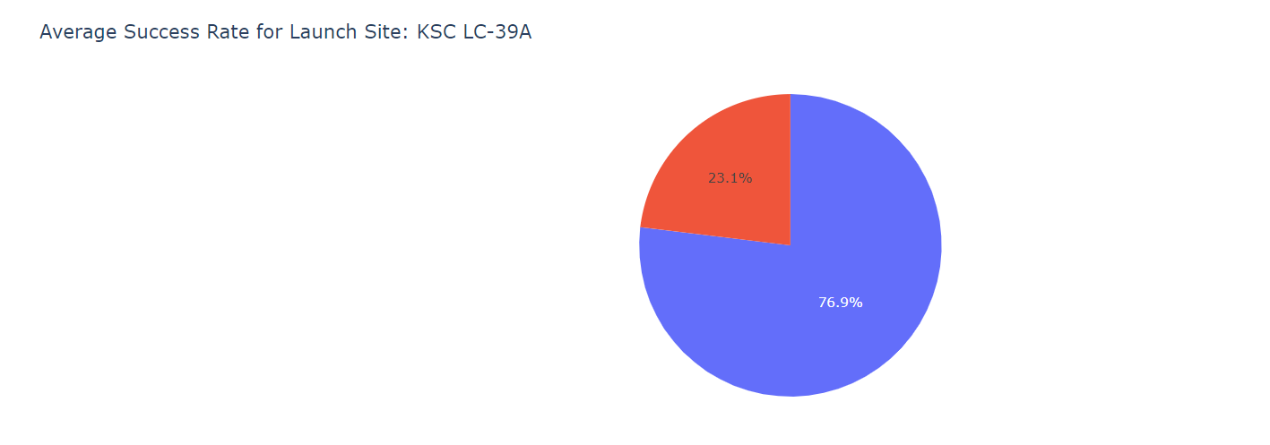
KSC LC-39A has the success rate of 76.9%

Slide 41
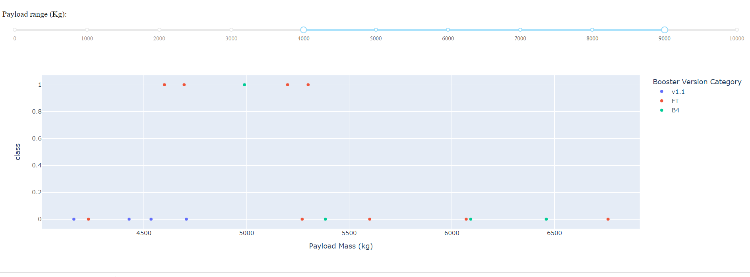
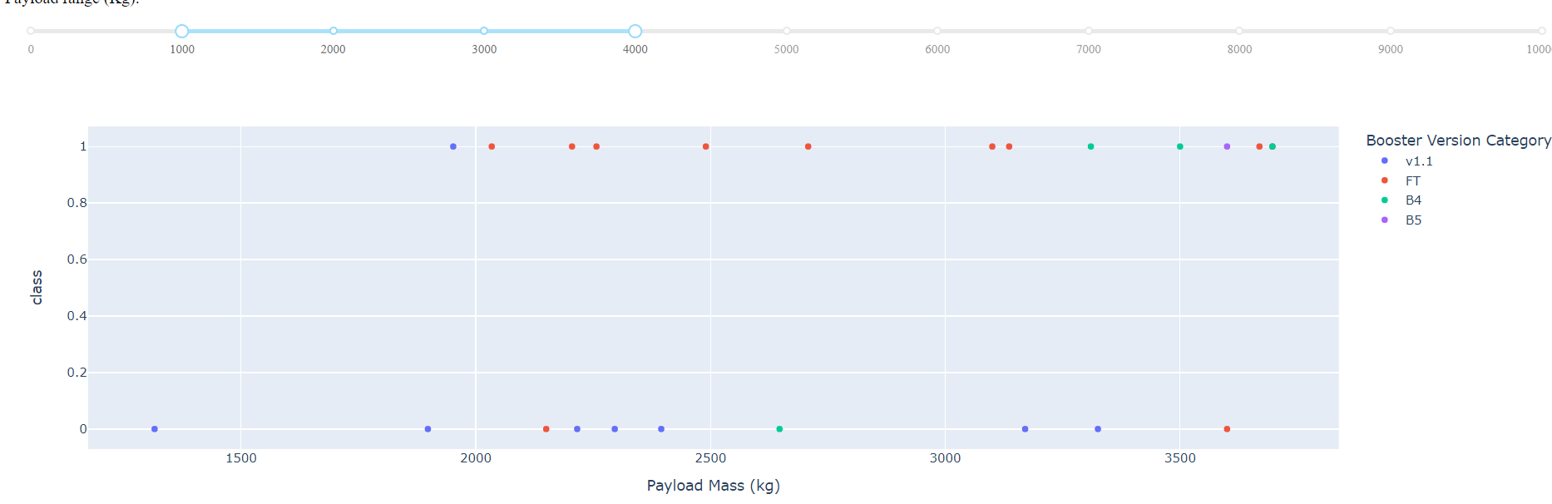
Payload Mass between 4000 and 9000
Payload Mass between 1000 and 4000
Lower the Payload Mass higher is the success

Slide 42

Predictive Analysis (Classification)

Slide 43
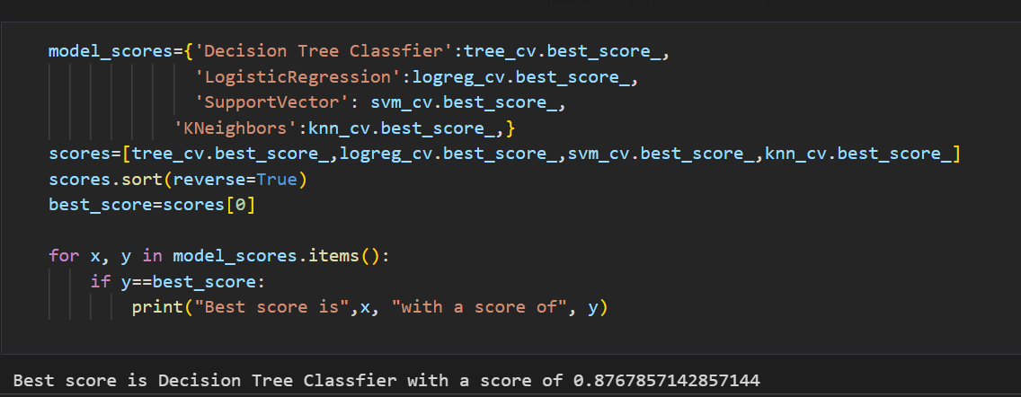
Classification Accuracy
We can see that Decision Tree Classifier Achieves maximum accuracy Score

Slide 44

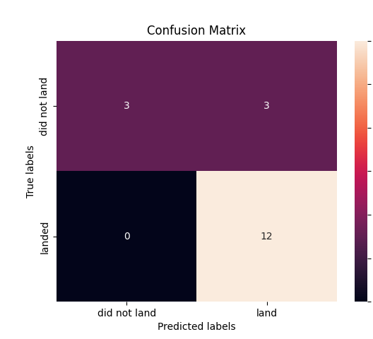
Confusion Matrix of Decision Tree Classifier

Slide 45
Conclusions
Orbits ES-L1, GEO, HEO, SSO, VLEO has most success rate (nearly 100 percent).
Success rate is increasing every year
All the launch sites are near Equator
All the launch site are near the coastline
Decision Tree classifier outperformed all the other predictive models

Slide 46


